Slide 1
Kotlin for Android
Getting started with kotlin

Slide 2
What is Kotlin ?
Statically typed programming language for the JVM, Android and the browser.
The language was created in response to limitations in Java which were hindering development of JetBrains' software products and after an evaluation of all other JVM languages proved unsuitable. Since the goal of Kotlin was for use in improving their products, it focuses very strongly on interop with Java code and the Java standard library.
Notes:
What is kotlin

Slide 3

Known limitation in JAVA
Inability to add method to platform types

Slide 4

The Billion Dollar Mistake
Null Pointer Exception

Slide 5

Tracing Null Pointer Exception

Slide 6

Why to use kotlin ?
100% Java Interoperability
Null Safe
Combine the Best of Functional and Procedural Programming
Concise code
Smart Casting
Default Arguments
Named Arguments
Official programming language for Android

Slide 7
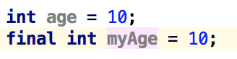
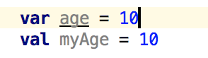
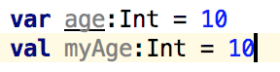
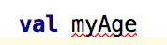
Basic Syntax
Variable and Constants in java
Variable and Constants in Kotlin
Type inference
Manual Type
Compiler give error about type annotation or initialize variable

Slide 8
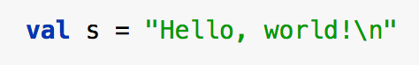
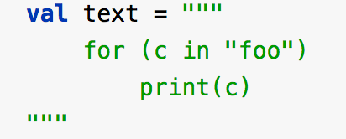
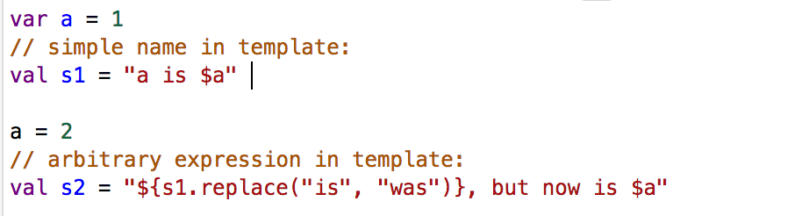
String
Kotlin have two type of string literals
Escaped String
Raw String
String Template

Slide 9
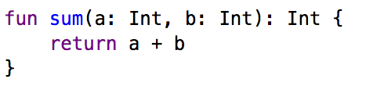
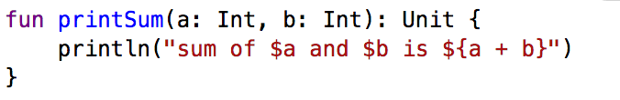
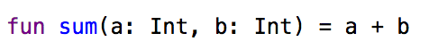
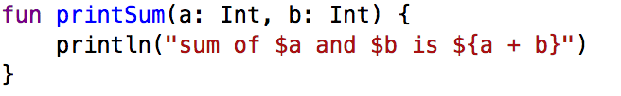
Functions in Kotlin
Function are defined using keyword fun
Default return type of any function is Unit
Function with an expression body and inferred return type:

Slide 10
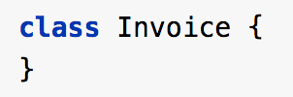
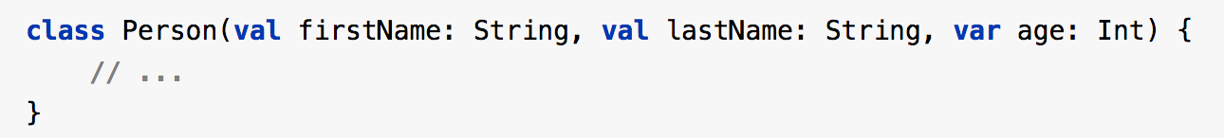
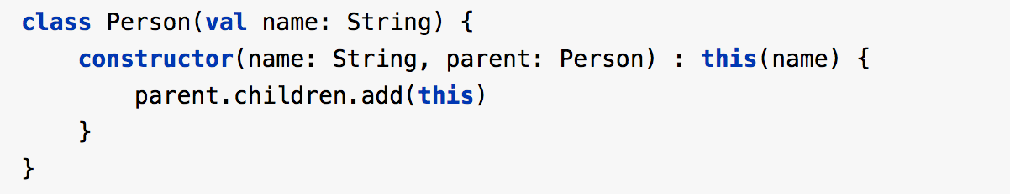
Classes in Kotlin
Classes are declared using keyword class
Primary Constructor in kotlin
Secondary Constructor in kotlin
Notes:
pr

Slide 11
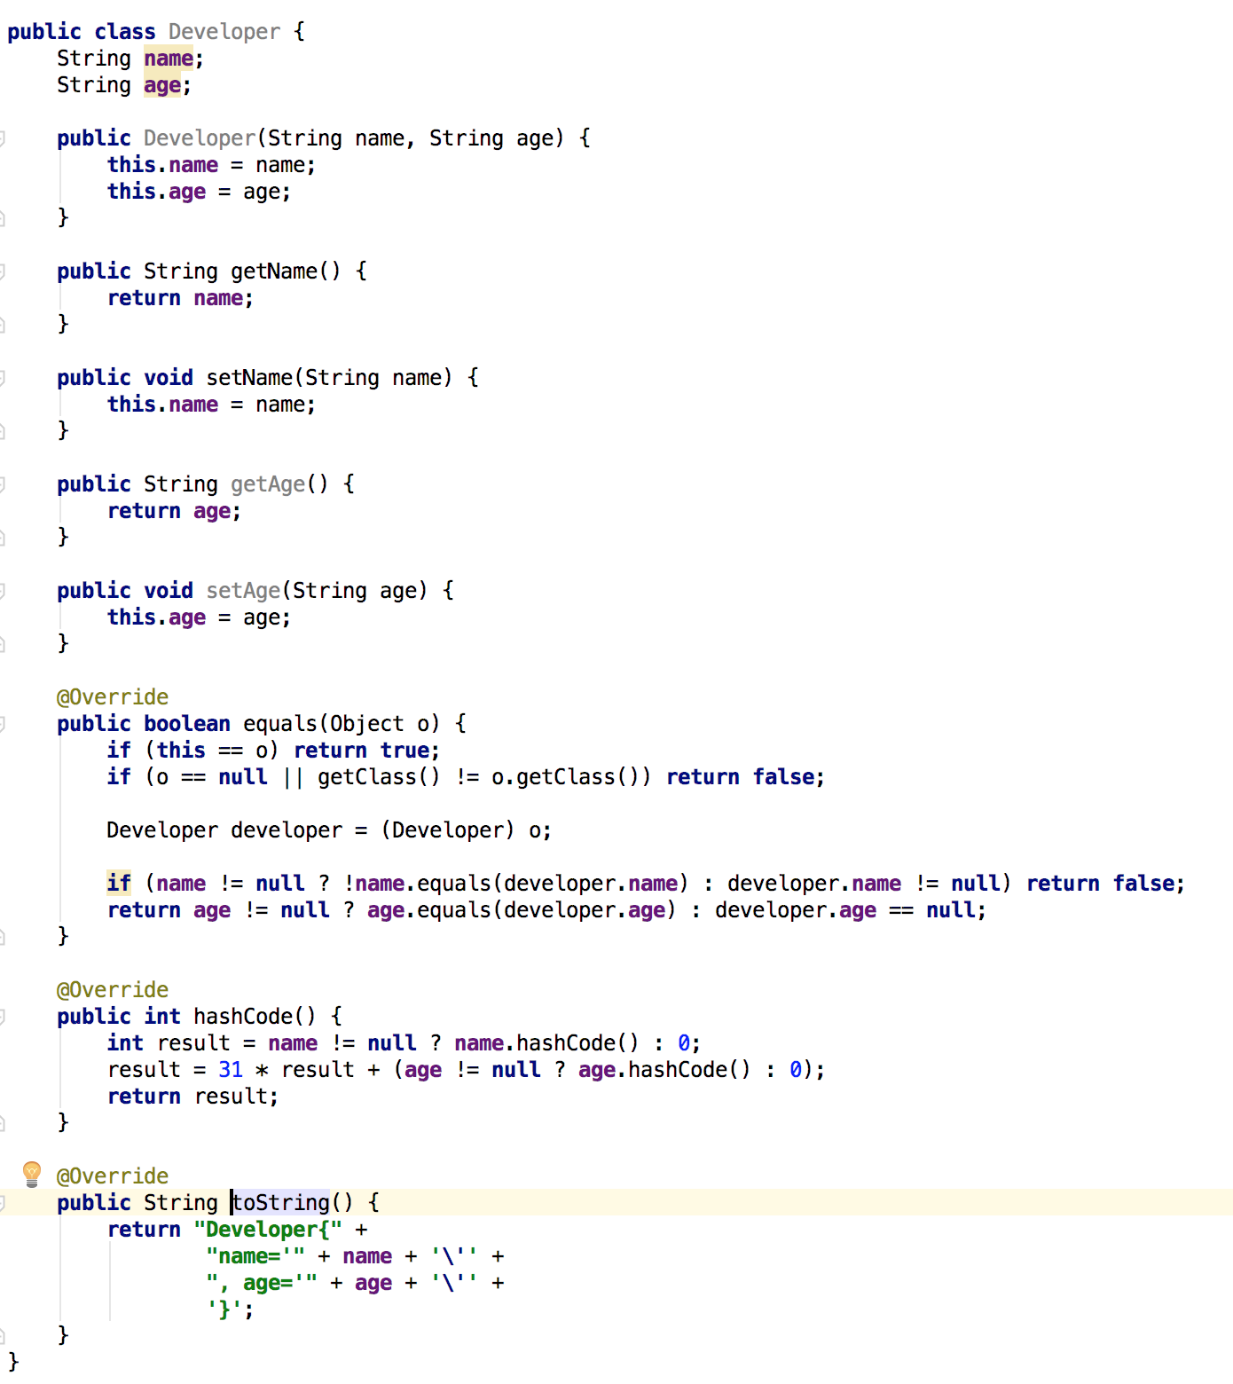
Java Bean Class

Slide 12

Same Java Bean class in Kotlin
When we mark a class as a data class.
hashCode()
equals()
toString()
copy()

Slide 13


Slide 14
Requirement to make data class
The primary constructor needs to have at least one parameter;
All primary constructor parameters need to be marked as val or var;
Data classes cannot be abstract, open, sealed or inner;

Slide 15
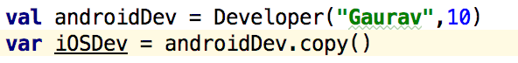
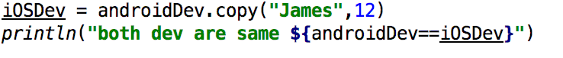
Copy objects
TRUE (Property equality)
False
False(Referential equality)

Slide 16
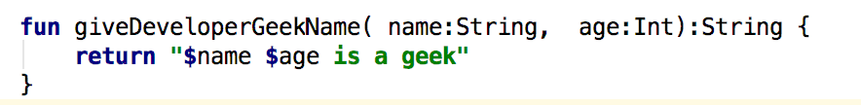
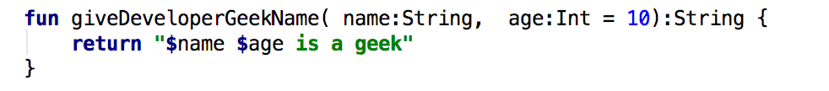
Named Arguments
O/p James 17 is a geek
Default Arguments
O/p Gogo 10 is a geek

Slide 17
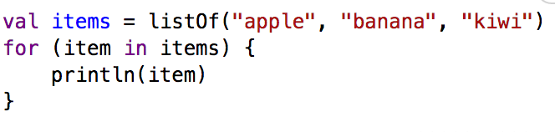
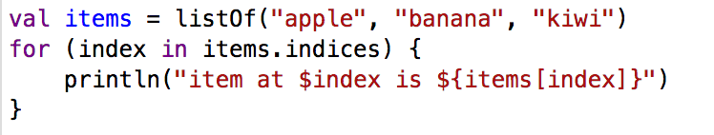
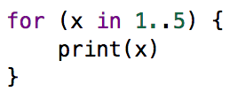
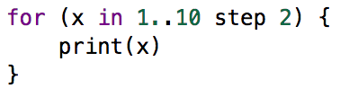
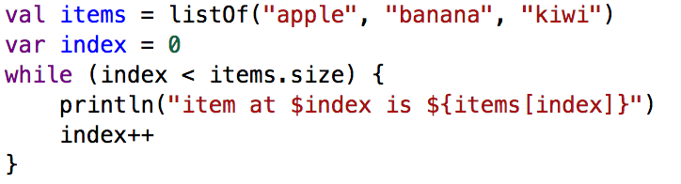
Loops in kotlin
For loop
For loop using range
For loop using range with progression
While loop

